Slide 1
Faith Lutheran’s 2024 Stewardship Drive
Growing Our Faith
Through Generosity

Slide 2


Slide 3
Week Three
Your generosity serves our
WORLD

Slide 4
How our generosity helps our world:
Quilts
  72 quilts sent with Hurricane Helene recovery supply truck
  25 quilts given each year for Port Isabella Mission for the poor in Texas
  15 boxes of quilts sent to Lutheran World Relief for distribution to those in need around the world

Slide 5
World Hunger
  Faith gives 1% of our total income each year + additional donations from individual members
    2023 – Total given - $5,256
    2024 – Given YTD - $5,005

Slide 6
Lutheran World Relief
  Faith gives 1% of our total income each year
      2023 – Total given - $3,875
      2024 – Given YTD - $2,851

Slide 7
Crossways Bible Camps
  Faith gives 1% of our total income each year
      2023 – Total given - $3,875
      2024 – Given YTD - $2,851

Slide 8
Lutheran Social Services
  Faith gives 1% of our total income each year
      2023 – Total given - $3,875
      2024 – Given YTD - $2,851

Slide 9
East Central ELCA Synod of Wisconsin
  Faith gives 3% of our total income each year to ECSW
    2023 – Total given - $9,594
    2024 – Given YTD - $8,553

Slide 10
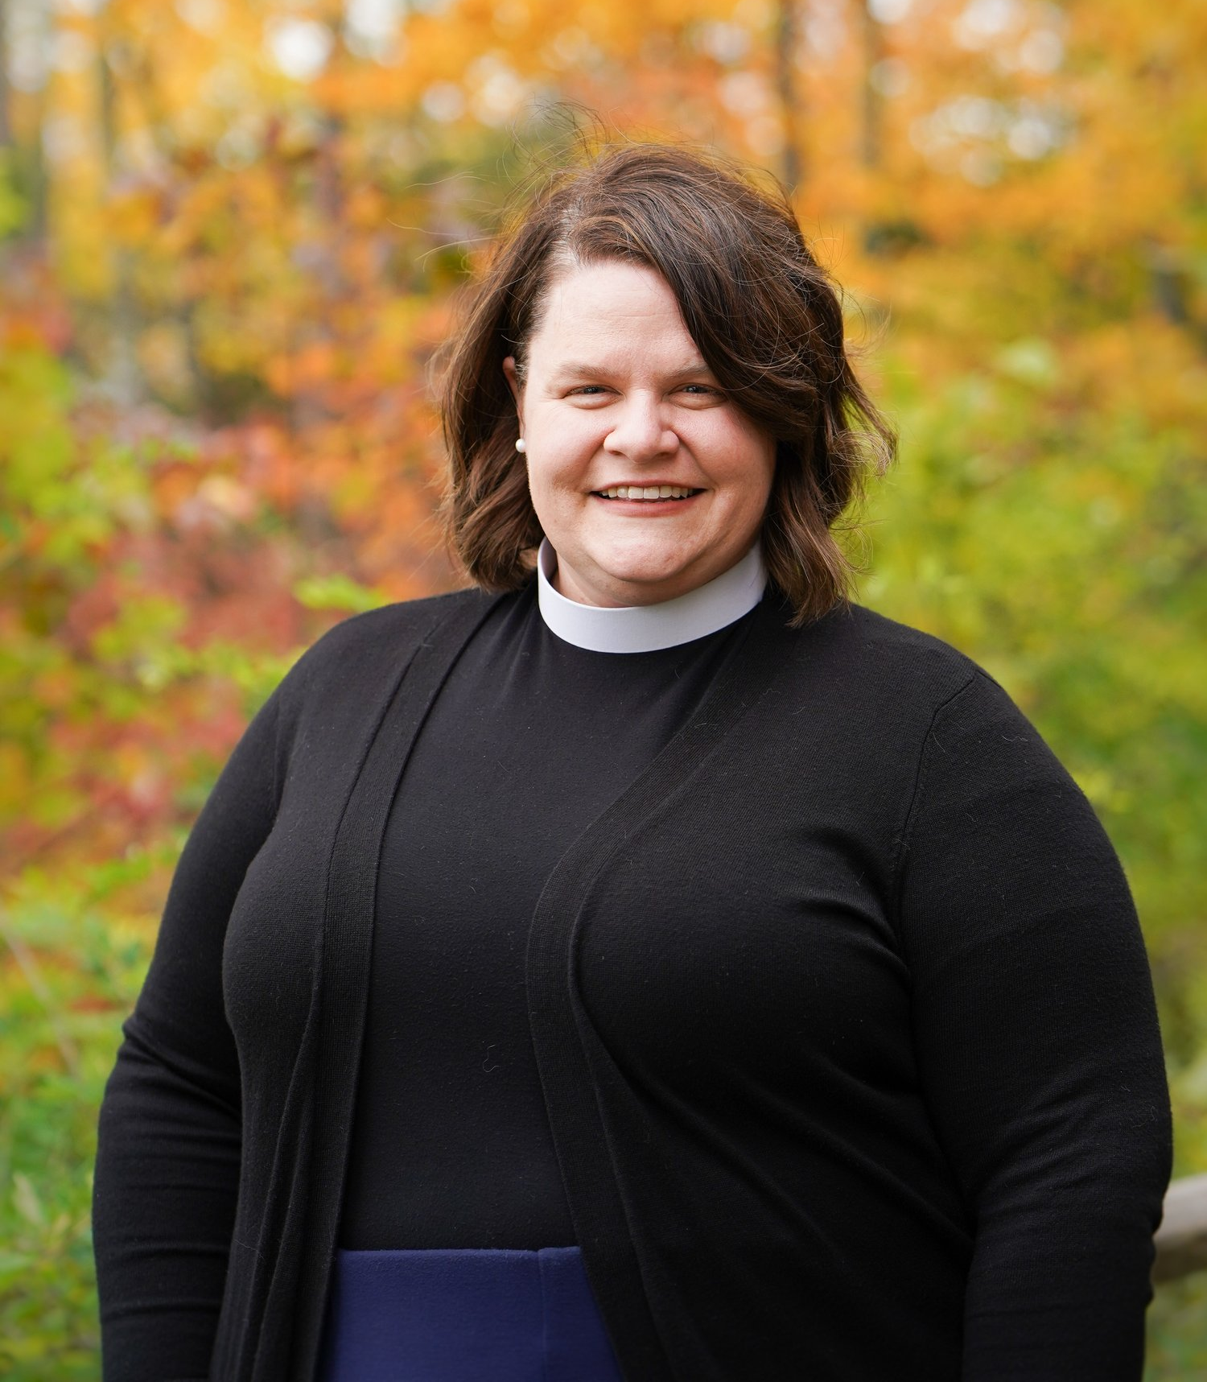
Our Speaker - The Reverend Jenn Pockat
Associate to the Bishop, Director for Relationships & Resources
Pastor Jenn Pockat (pronounced, pa-KOYT) was called by the East Central Synod of Wisconsin Council to serve as Associate to the Bishop in April of 2021. Pastor Jenn works to curate resources for the synod: everything from stewardship to policy and practical aspects of ministry. She also tends to our communal life: convening cohorts, providing one on one care or consultation. From 2012 - 2021, Pastor Jenn served Saint Andrew in Wausau, first as associate and then, starting in 2019, as lead pastor. She is a graduate of Luther College and Wartburg Seminary and has served as treasurer on the board of Crossways Camping Ministries and is the staff liaison for the ECSW lay school. Pastor Jenn is married to Don and lives on a hobby farm in Caroline, in rural Shawano County. She loves spending time with her cats and working in the garden.

Slide 11
https://drive.google.com/file/d/1SAWpnK1ZWOg8KJbpaBF3e7Qo-8fXZCoh/view?usp=sharing

