Slide 1
Faith Lutheran’s 2024 Stewardship Drive
Growing Our Faith
Through Generosity

Slide 2


Slide 3
Week Two
Your generosity serves our COMMUNITY

Slide 4
Faith’s Community Pantry
  Managed by Sandy Halverson with help from our Endowment Committee
  Donations are received from members of Faith Lutheran, St. Mary’s/St. Michael’s, Peter’s Pantry, Valders Lions, & many members of the community
  Also supported as needed financially through Faith’s Endowment funds
      2023 - $3,747
      2024 YTD - $1,255

Slide 5
Faith’s Community Pantry
Pantry is open from 9:00 am to _______ the 3rd Saturday of each month
Serve between 12 and 18 families each month
28 families have been served in 2024 YTD
  Always need donations of food items – list is provided in each bulletin and on the website under Announcements (You may also donate funds to purchase food items)

Slide 6
Quilting Ministry
    Quilting leaders are Cheryl Domrath, Marlene Evenson, & Kaylene Halderson
The quilting group is made up of members of Faith Lutheran, St. Mary’s/St. Michael’s, St. Gregory’s, who get together weekly to do quilting tasks at Faith and enjoy fellowship.
Many also do quilting tasks at home in addition to the weekly quilting events.

Slide 7
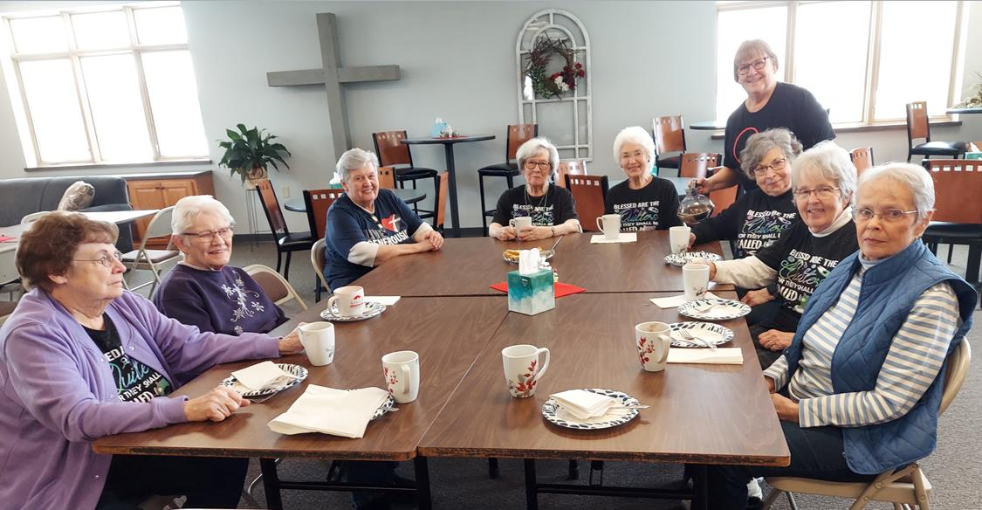

Slide 8
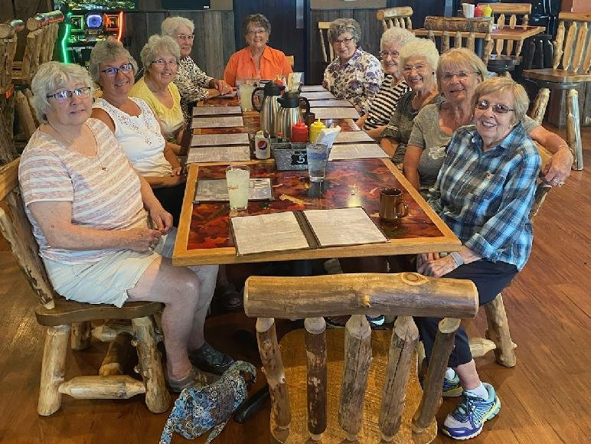

Slide 9
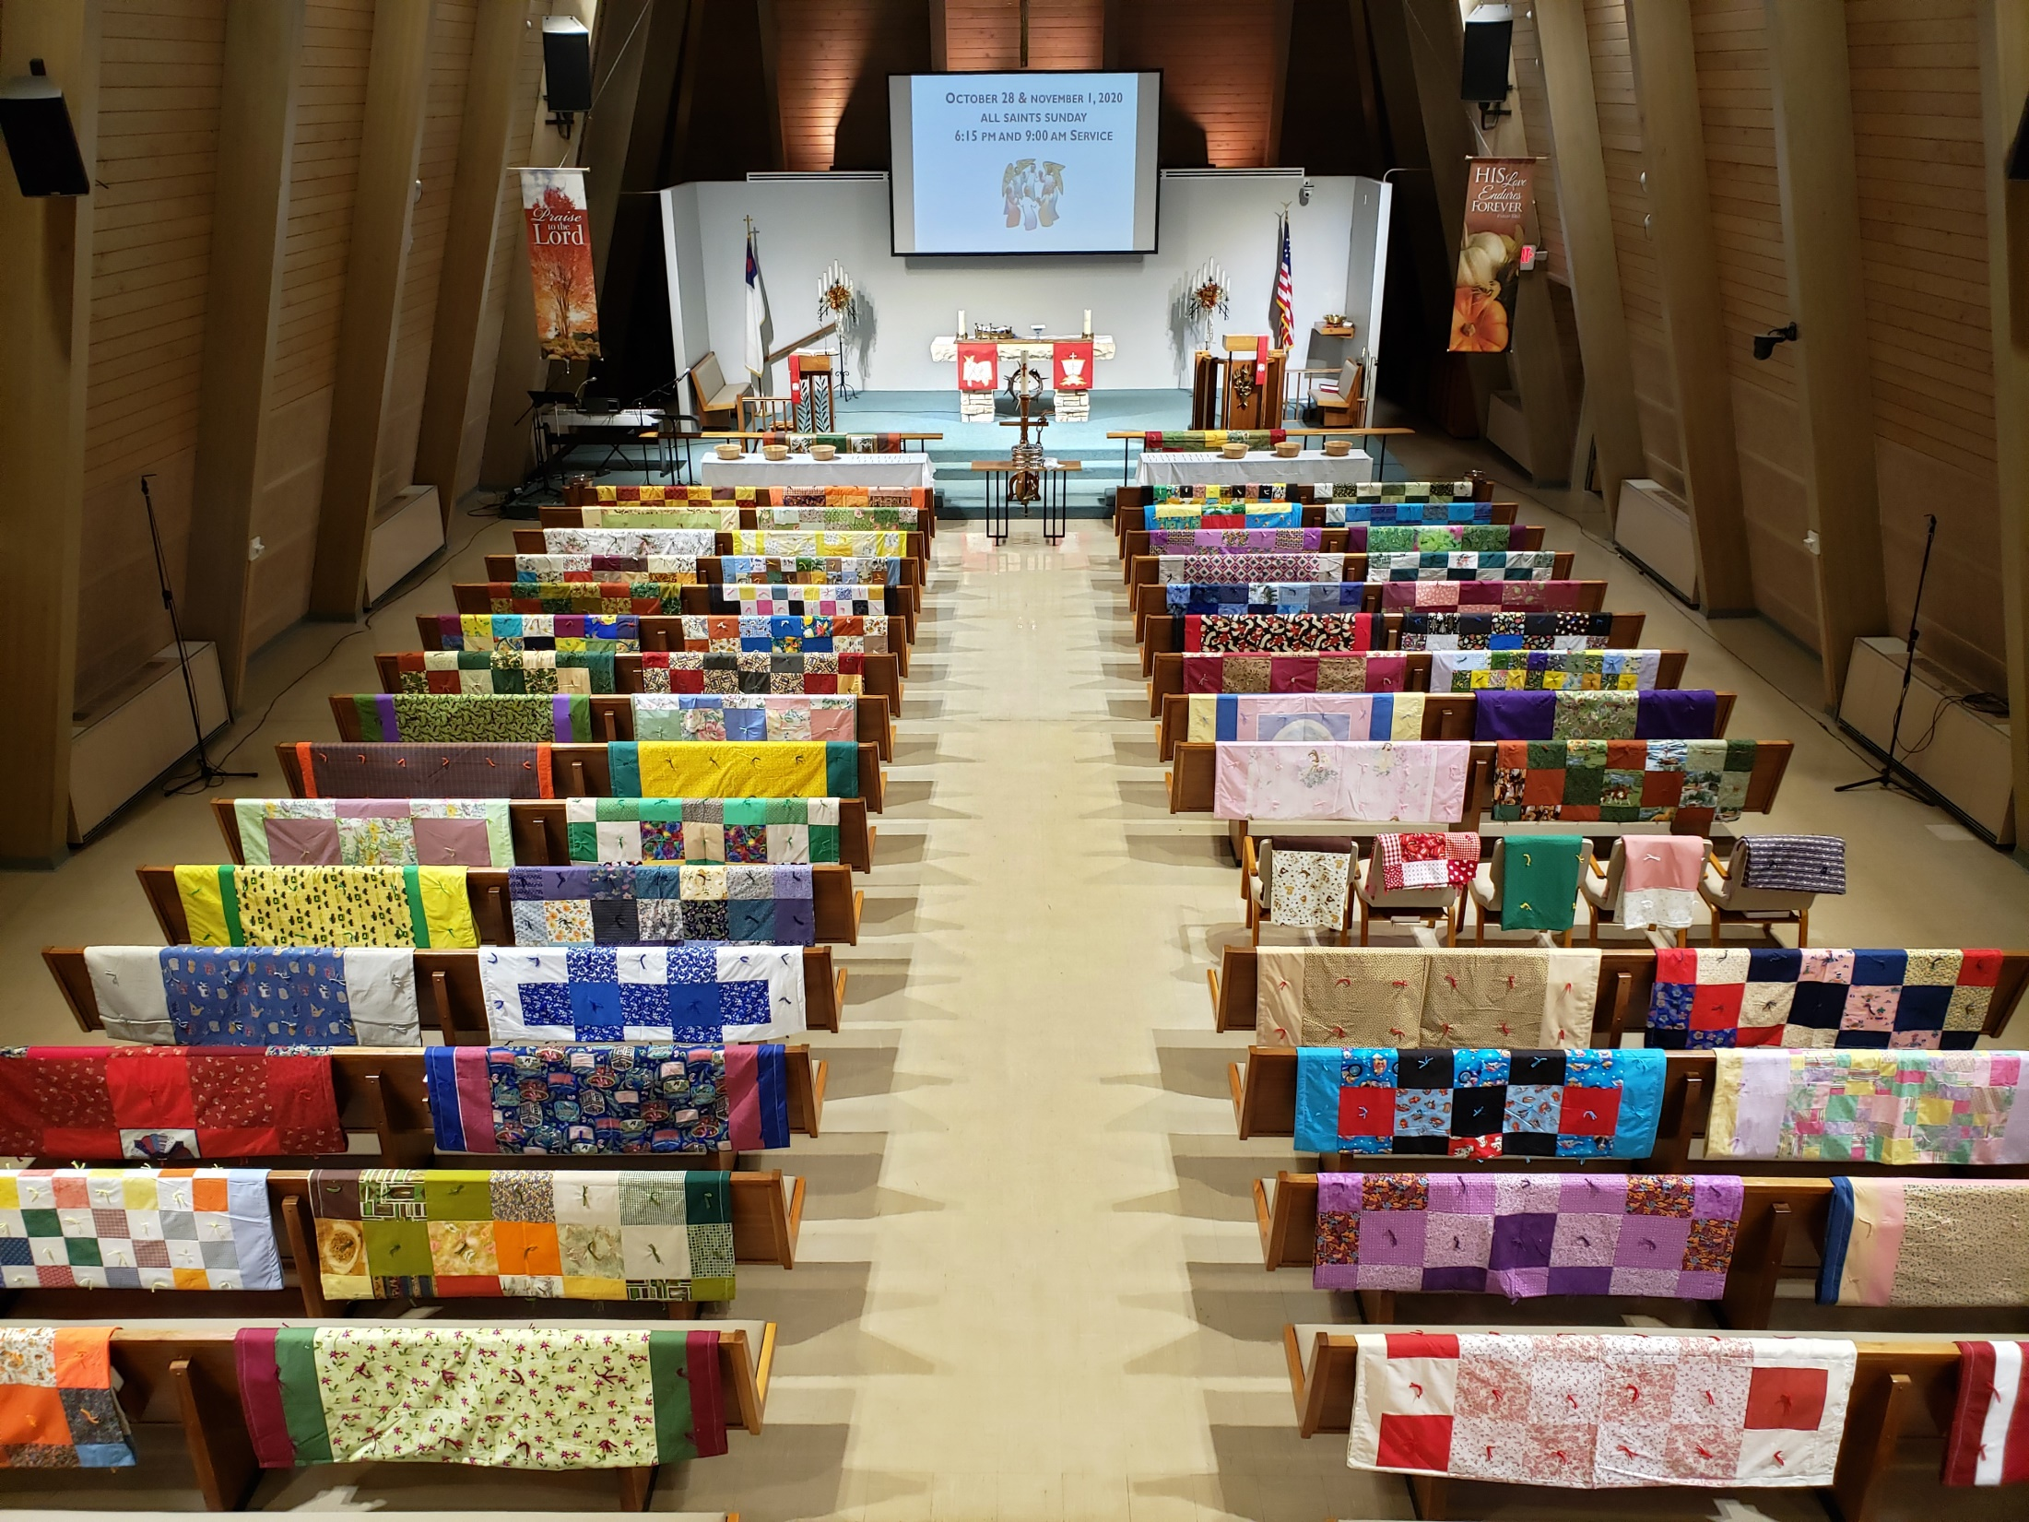

Slide 10
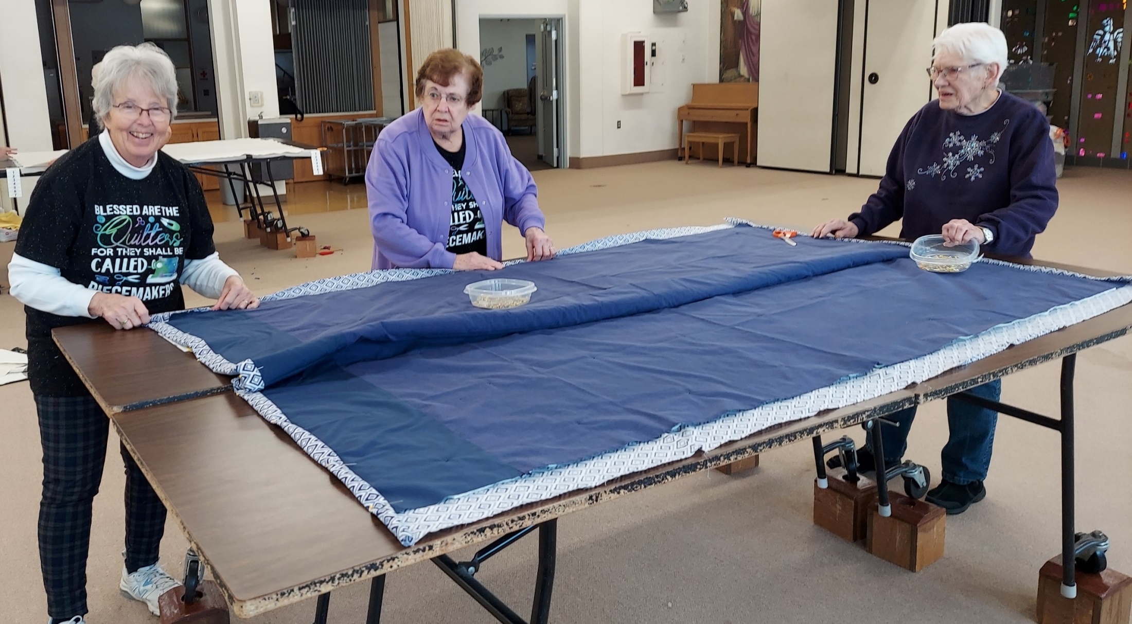

Slide 11
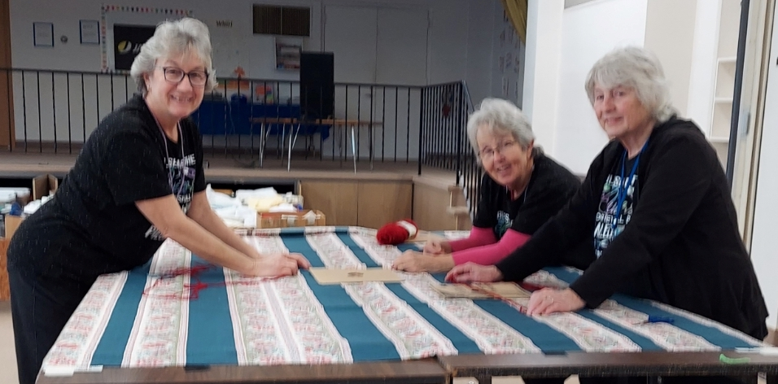

Slide 12
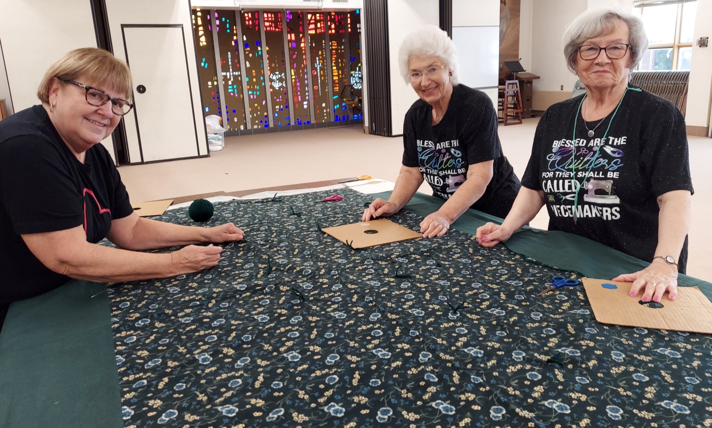

Slide 13
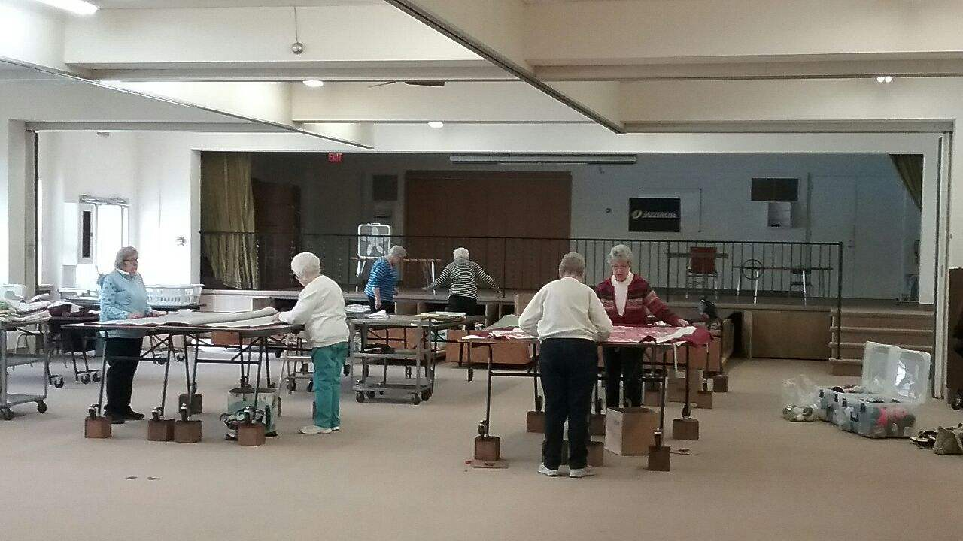

Slide 14
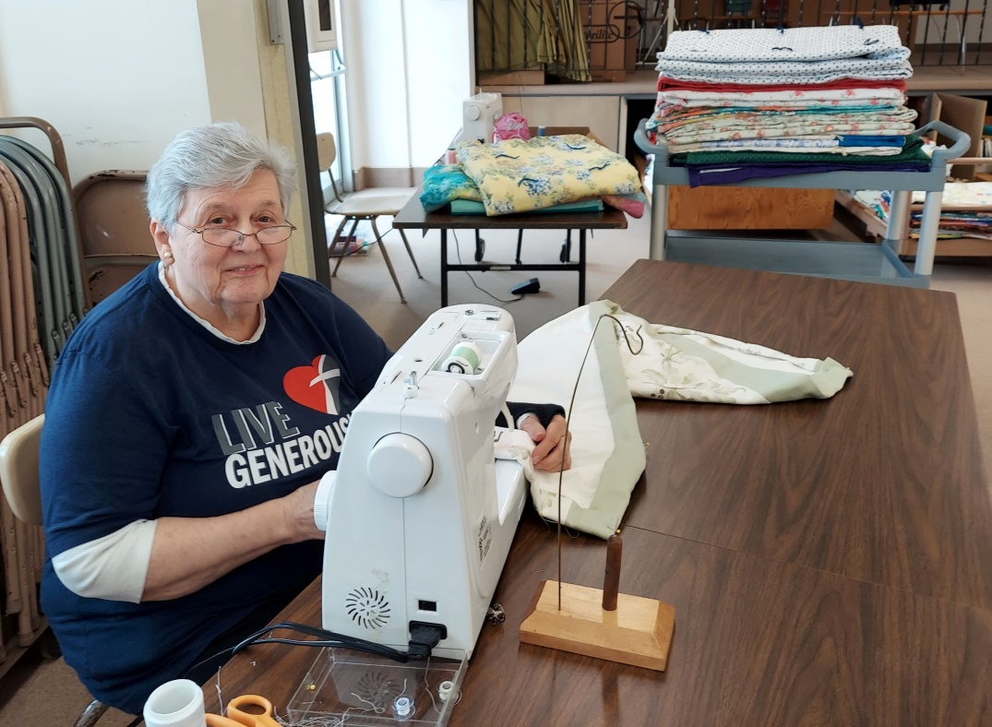
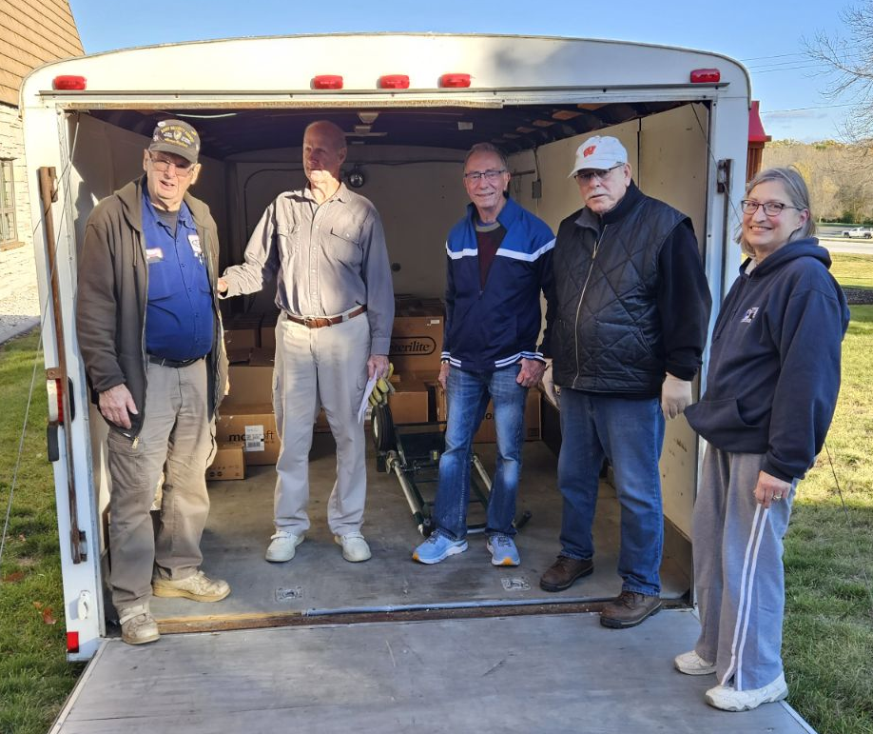
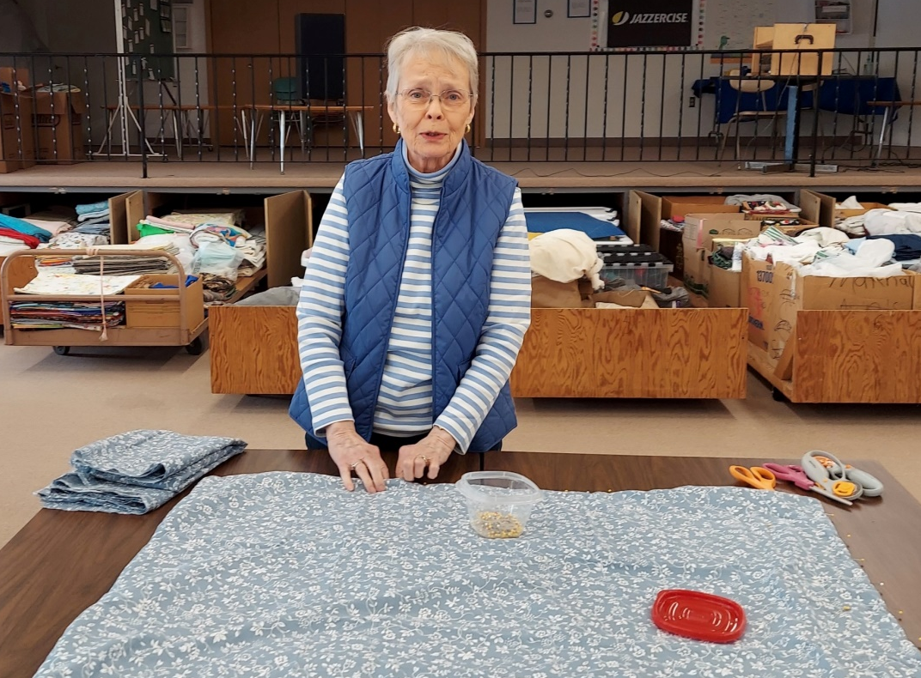
Quilters meet most weeks on Thursday mornings beginning at 8:00
Quilts are packed for Lutheran World Relief in October and taken to Sheboygan

Slide 15
  Quilts are given within our community to:
    Salvation Army (100)
    Nursing Home residents
    St. Mary’s/St. Michael’s Prayer Partners
    Valders School families
    Hope House
    Lakeshore Foster Families & Friends
    InCourage
    The Crossing
    Pantry recipients in December
    Manitowoc County homeless people in December

Slide 16
Vacation Bible School
Faith’s amazing VBS is open to our community
Vacation Bible School (VBS) is held for a week in June each year during Summer School at Valders Public School
Valders Bussing drops Valders Summer School students, who attend VBS, off at Faith
In 2024, we had 70 students participate and 30 volunteer helpers

Slide 17
Soup for the Souls
Soup, made by a group of Faith’s volunteers, is taken to members of Faith & non-members from our community following a recent hospitalization or surgery, and also to shut-ins during communion visits
Prepared soup is usually available in the Gathering Space refrigerator if you know of someone in need

Slide 18
Sharing Tree
A “Sharing Tree” is made available each year in the Gathering Space usually in November
Members of Faith may choose to donate one of the gift suggestions hanging on the tree
These gifts, donated by our members, are given to local families in need, as determined by the Salvation Army

Slide 19
Health Day Event
This is a recent offering to our community, providing education on various health topics
The first event took place in 2023
The second event is planned for October 12th

Slide 20
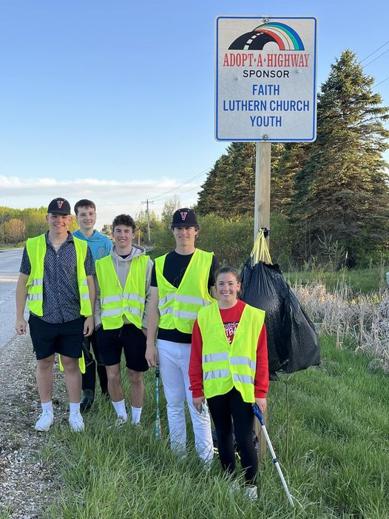
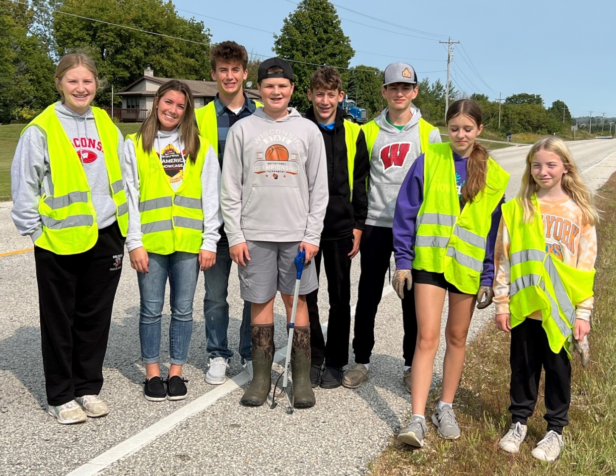
Highway
Clean-up
By Faith’s Youth

Slide 21
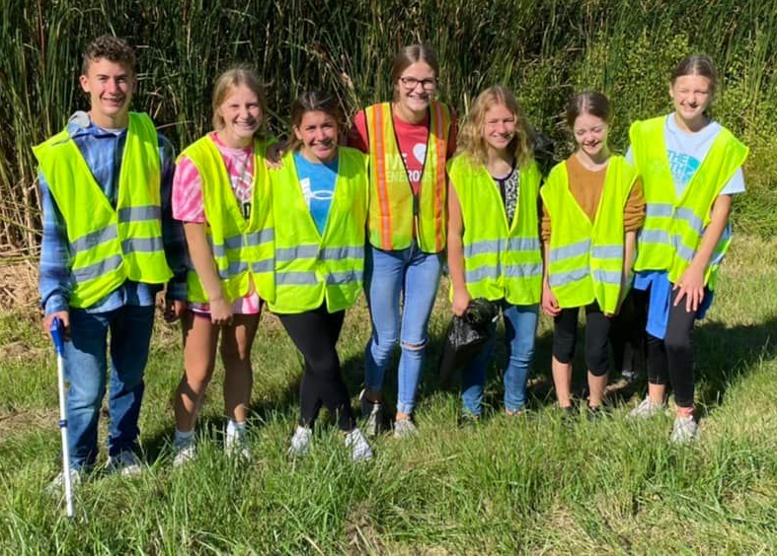

Slide 22
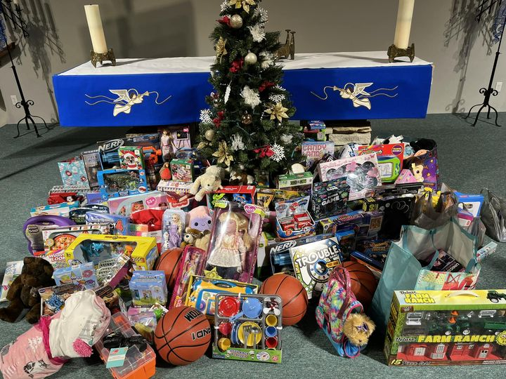
In as Much Gifts

Slide 23
Faith’s Endowment Fund
Provides support to families in need through local schools
    2024 - $4,000
    2024 YTD - $1,250

Slide 24
Community Non-Profits
The Haven - $348
Hope House - $348, Quilts
InCourage - $262, October supply drive, Quilts
Pine Haven Christian Communities - $605
The Crossing - Quilts
Warming Shelter ?

